Slide 1
How Random Walk Influences Our Decision Making Process
Noah Gallagher
1

Slide 2
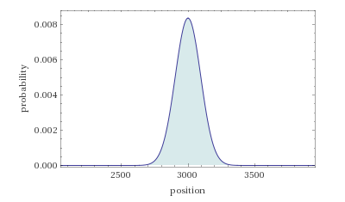
Making Decisions
Assume you flip a coin 10,000 times and for heads you take a step forwards. For tails, you take a step backwards.
Let’s say the coin is unfair and lands 65% on heads. How far would you get? Probability tells us that we would average at 3,000 steps forward.
Simulating a Random Walk with forward p=0.65 with steps=10,000
2

Slide 3
The intent of the study is to show that decision making isn’t binary and follows some type of Random Walk.
How does random walk affect this?
Factors that an affect Decision Making include:
Probability of Correct Decision
Speed of Decision
Size of Decision
3

Slide 4
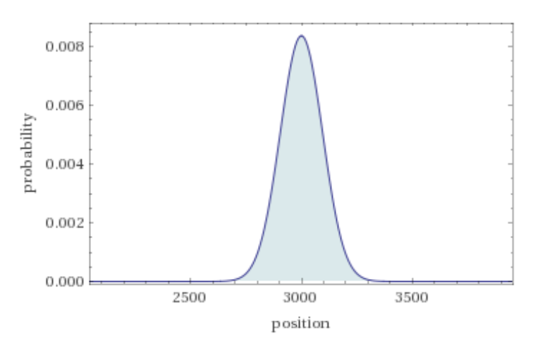
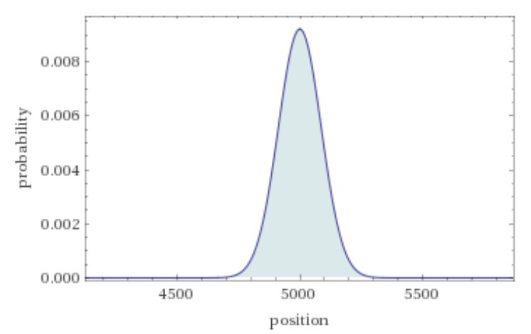
Probability of correct decision
Random Walk simulation with p=0.65 & 1,000 steps
Simulating with Random Walk, we can see that:
If you make a correct decision more frequently, the further forward we move towards success.
A 10% increase in successful decision-making results in 2,000 more steps forward.
Random Walk simulation with p=0.75 & 1,000 steps
4

Slide 5
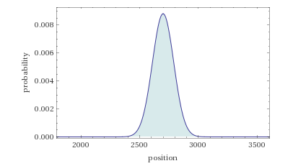
Speed of Decision
Original
Random Walk with forward p=0.65 and steps=10,000
Decreasing Steps
Let's assume that we make decisions 10% slower, meaning we decrease the steps from 10,000 to 9,000
This leads to 250 fewer steps forward towards success, resulting in an 8.9% decrease in steps forward.
Random Walk with forward p=0.65 and steps=9,000
5

Slide 6
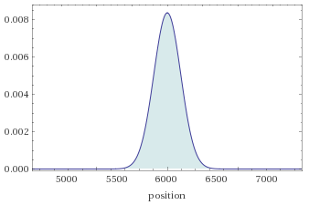
Size of Decision
To simulate this, we increase the step size in the Random Walk simulation.
A correct decision that is twice as important = 2 steps forward. An incorrect decision = 2 steps backwards.
Expected results should be doubled, yet if we start with a low value for p, we can get negative expected results.
Random walk simulation with forward p=0.65, steps=10,000, step size=2
6

Slide 7
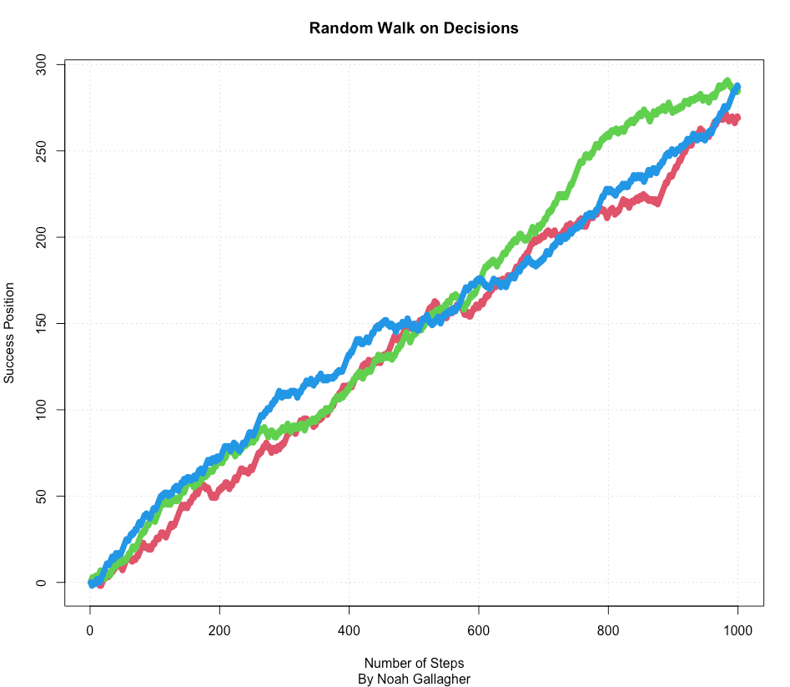
Simulating Trajectories in Favor of Correct Decision
#Specifying probability of correct decision
p<- 0.65
#Number of steps
nsteps<- 1000
#Number of trajectories
ntraj<- 3
#Turning walk into Matrix representation
rand.walk<- matrix(NA,nrow=nsteps, ncol=ntraj)
#Setting seed
set.seed(90823)
#Simulating Trajectories
for (j in 1:ntraj) {
rand.walk[1,j]<- 0
for (i in 2:nsteps)
rand.walk[i,j]<- ifelse(runif(1)<p, rand.walk[i-1,j]+1,
rand.walk[i-1,j]-1)
}
#Plotting Simulations
matplot(rand.walk, type="b", pch=16,lty=1, col=2:4, panel.first=grid(),
ylim=c(range(rand.walk)), ylab='Success Position', xlab='Number of Steps',
main="Random Walk on Decisions",sub="By Noah Gallagher")
7

Slide 8
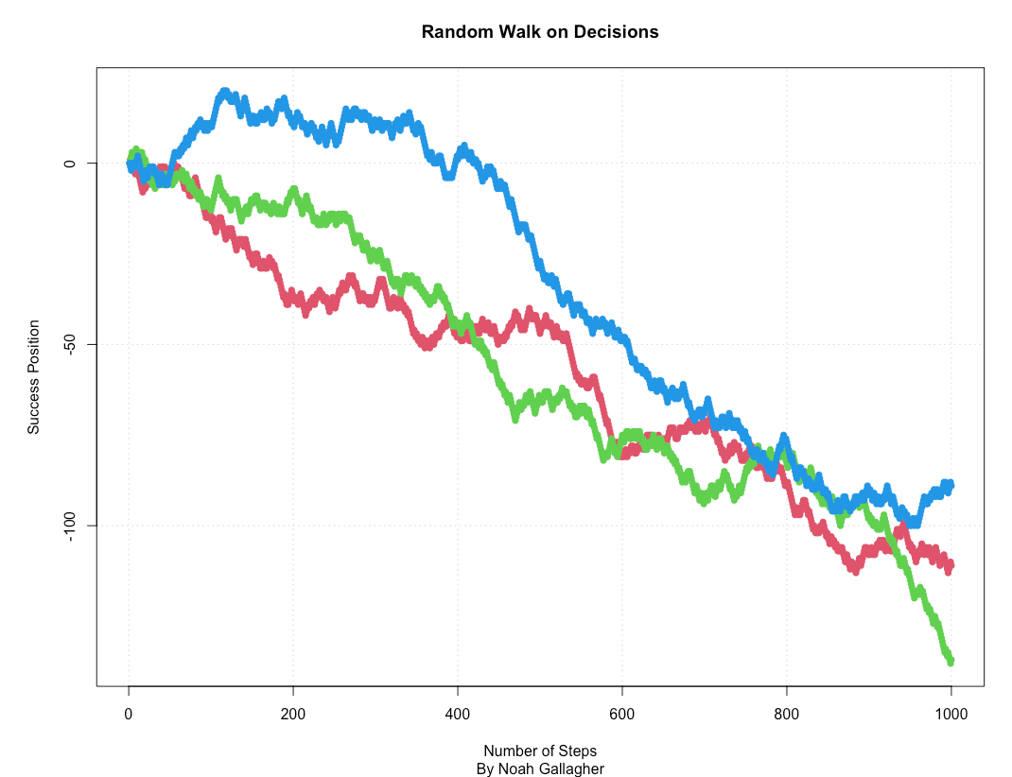
Simulating Trajectories in Favor of Wrong Decision
#Specifying probability of correct decision
p<- 0.45
#Number of steps
nsteps<- 1000
#Number of trajectories
ntraj<- 3
#Turning walk into Matrix representation
rand.walk<- matrix(NA,nrow=nsteps, ncol=ntraj)
#Setting seed
set.seed(90823)
#Simulating Trajectories
for (j in 1:ntraj) {
rand.walk[1,j]<- 0
for (i in 2:nsteps)
rand.walk[i,j]<- ifelse(runif(1)<p, rand.walk[i-1,j]+1,
rand.walk[i-1,j]-1)
}
#Plotting Simulations
matplot(rand.walk, type="b", pch=16,lty=1, col=2:4, panel.first=grid(),
ylim=c(range(rand.walk)), ylab='Success Position', xlab='Number of Steps',
main="Random Walk on Decisions",sub="By Noah Gallagher")
JUPITER is a gas giant and the biggest planet in our Solar System
VENUS has a beautiful name and is the second planet from the Sun
MERCURY is the smallest planet in our Solar System
8

Slide 9
Synthesis
From the article and simulating trajectories, we can conclude that:
Making the correct decisions is much more important that making decisions quickly.
Large decisions have a much larger influence on results, without sacrificing precision.
We can maximize performance by aiming for successful high-impact decisions while making unsuccessful low-impact decision.
9

Slide 10
THANKS!
Do you have any questions?
By Noah Gallagher
Reference:
https://towardsdatascience.com/decision-making-as-a-random-walk-6ed37e154633
Please keep this slide for attribution
10

